Slide 1















Raster Input
Layer-wise SVG Reconstruction (5 paths in total)
Raster Input SVG Output Editing color Editing eyes

Slide 2






Raster Input
Layer-wise SVG Reconstruction (left to right)

Slide 3









Slide 5






Input
Seg4
Seg8
Seg12
Seg16
Seg20

Slide 6


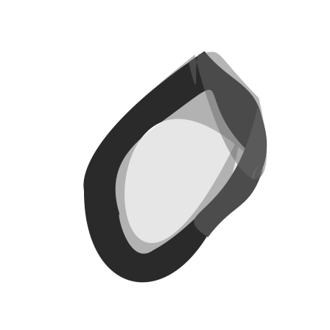
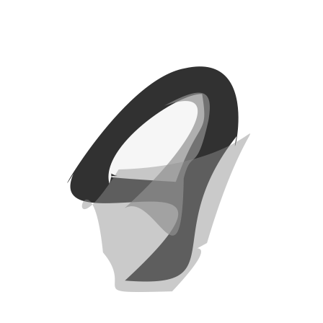
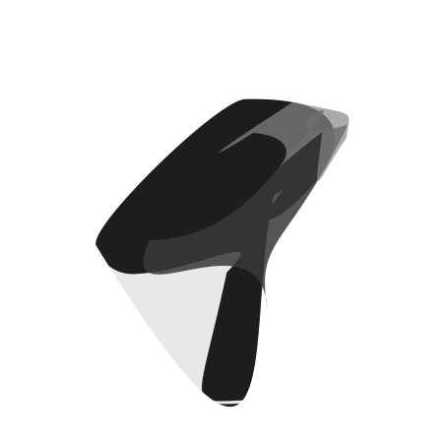


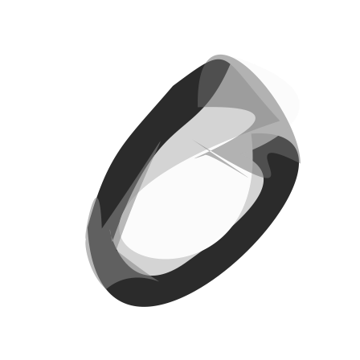
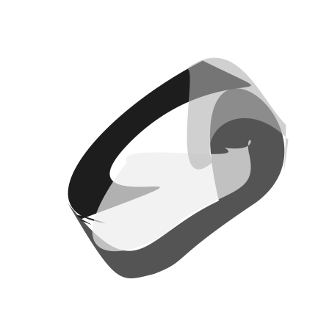


4
6
8
2

Slide 7









1 3 5 7 9
4
6
8
2

Slide 8







Slide 9







Slide 10



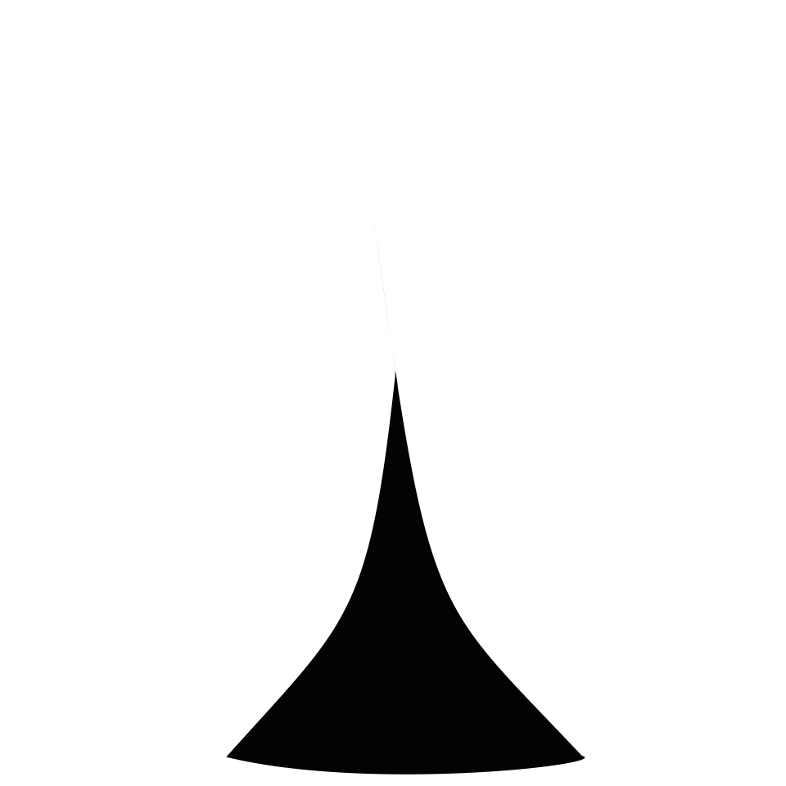








Slide 11

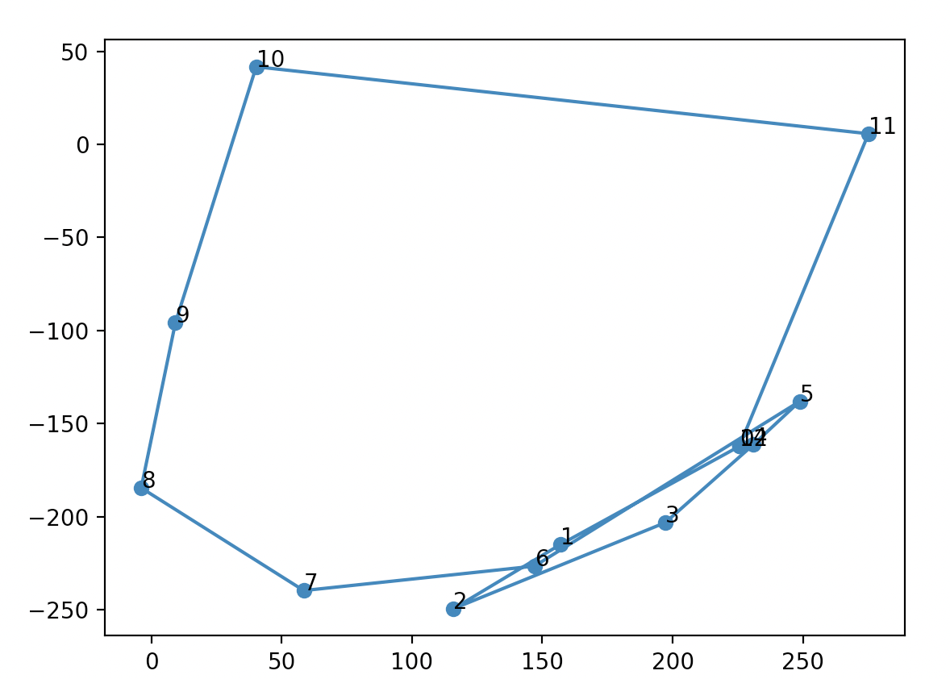

Slide 12

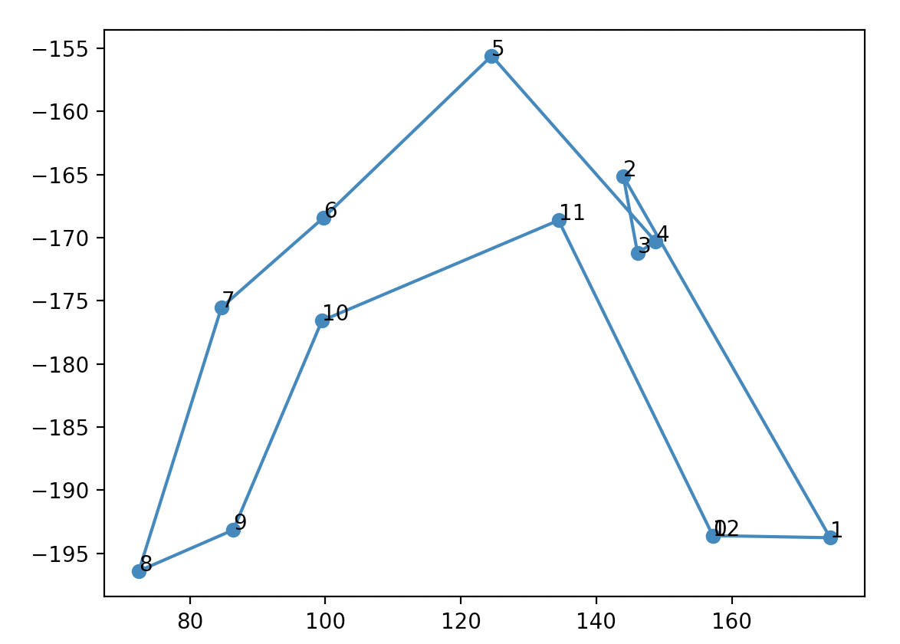

Slide 13

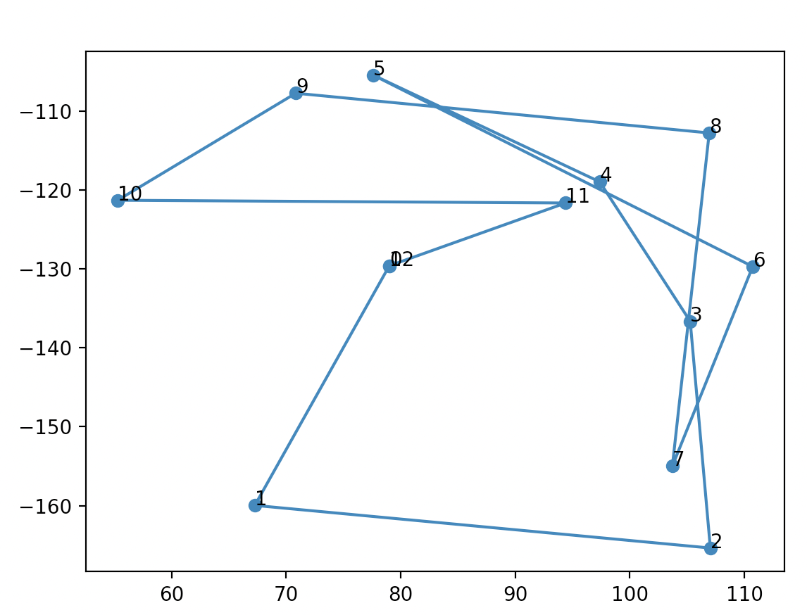

Slide 14

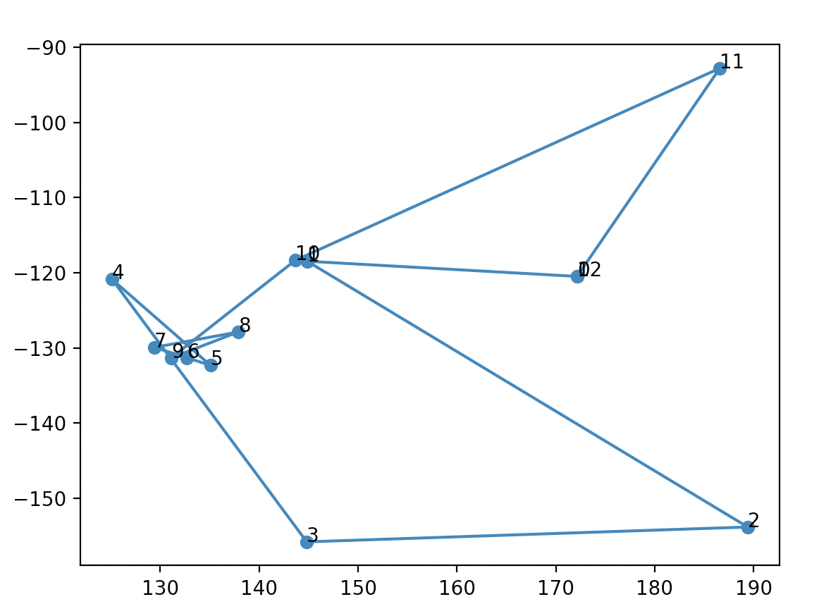

Slide 15

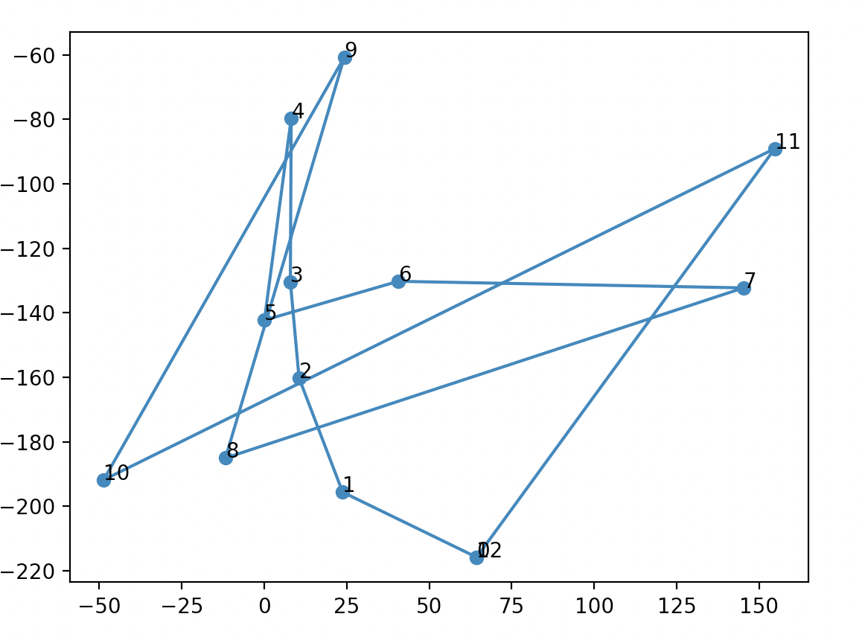

Slide 16

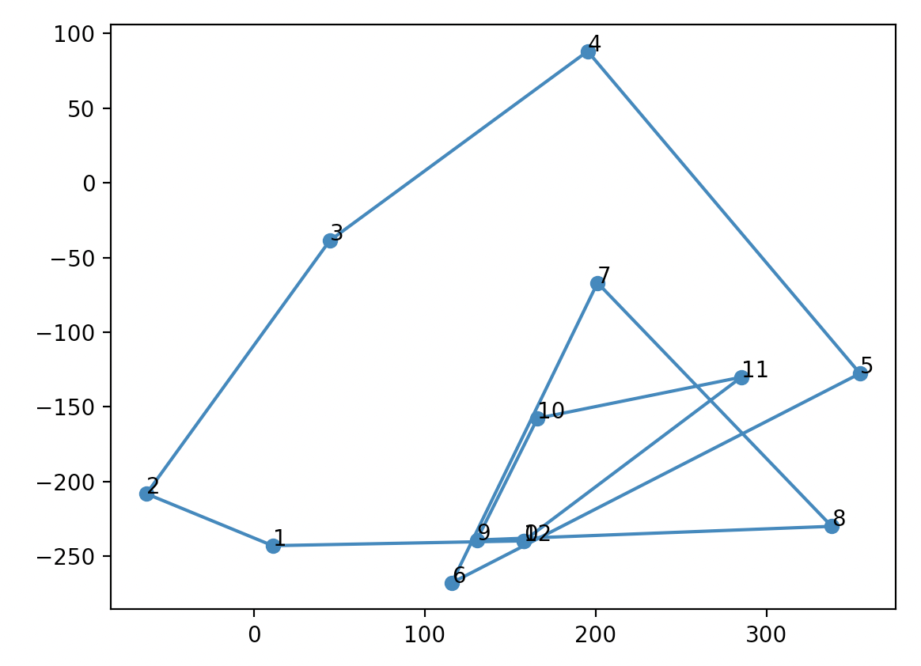

Slide 17

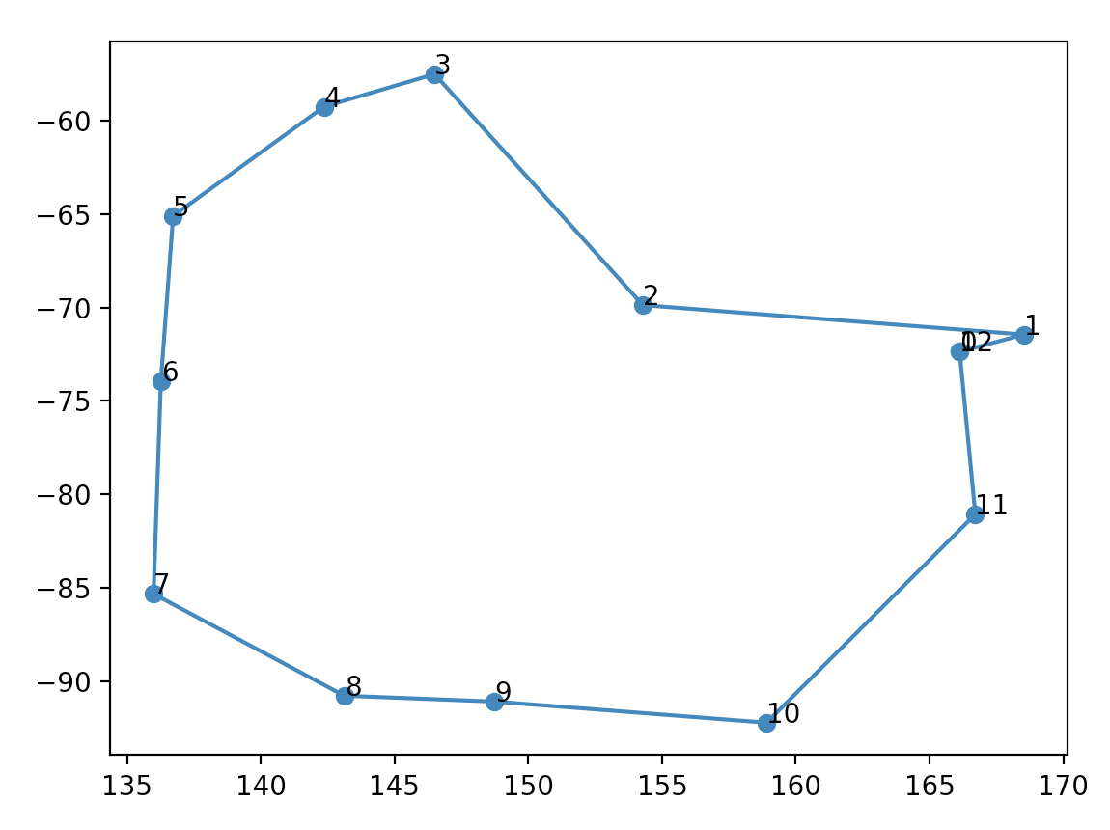

Slide 18

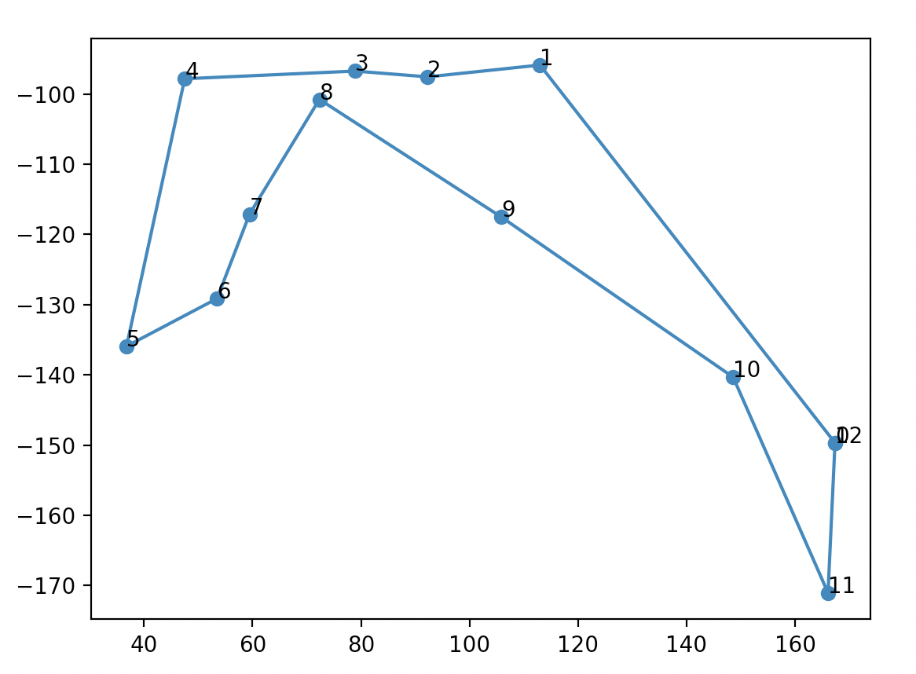

Slide 19
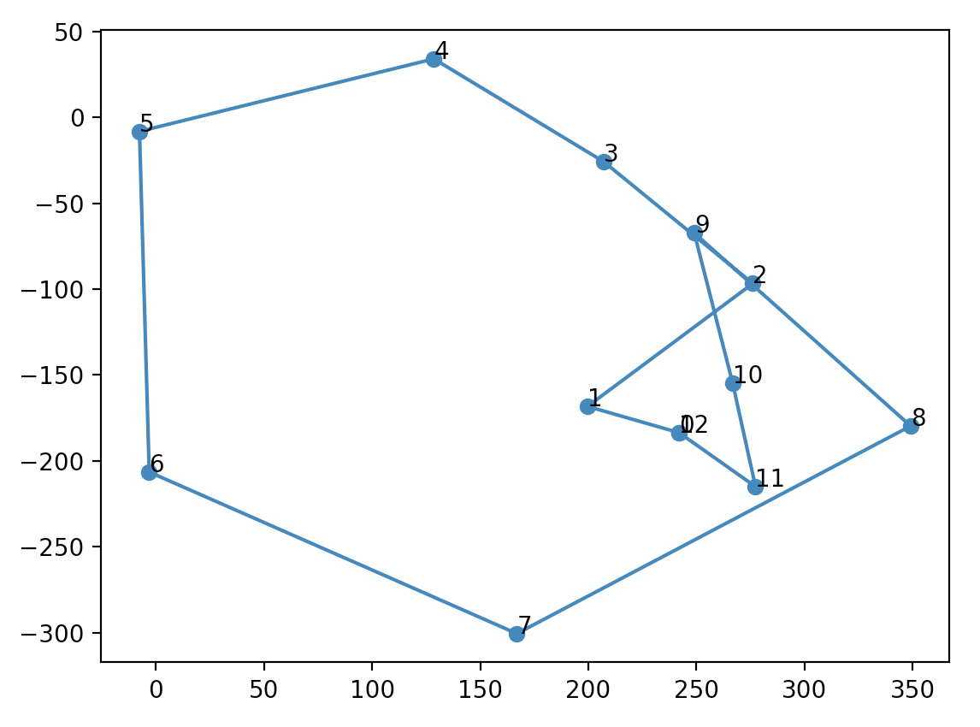


Slide 20

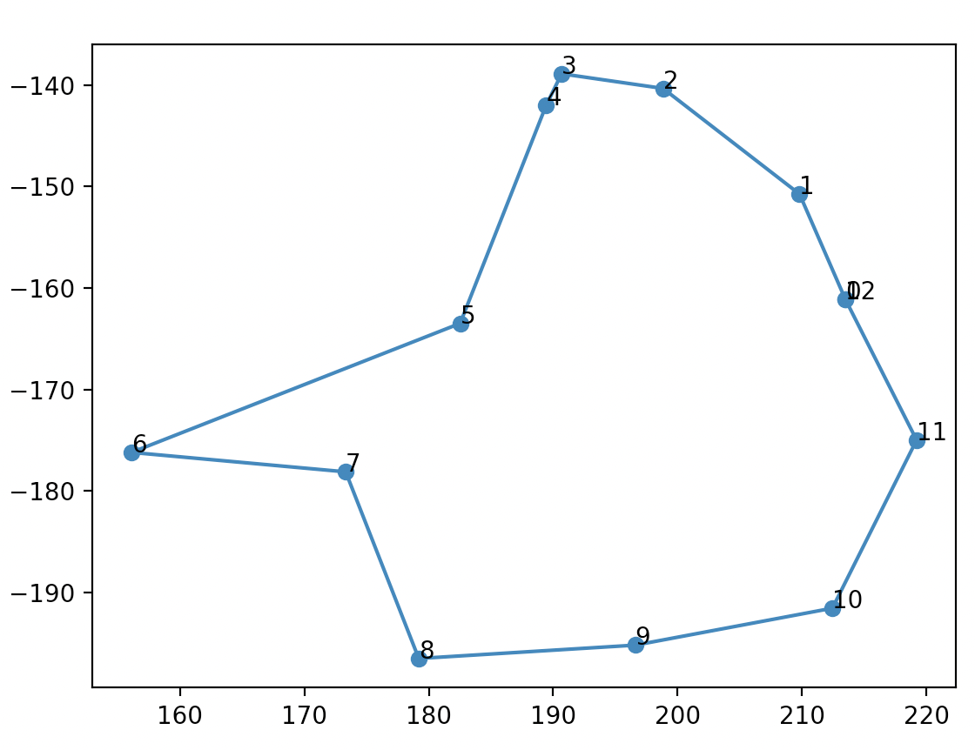

Slide 21

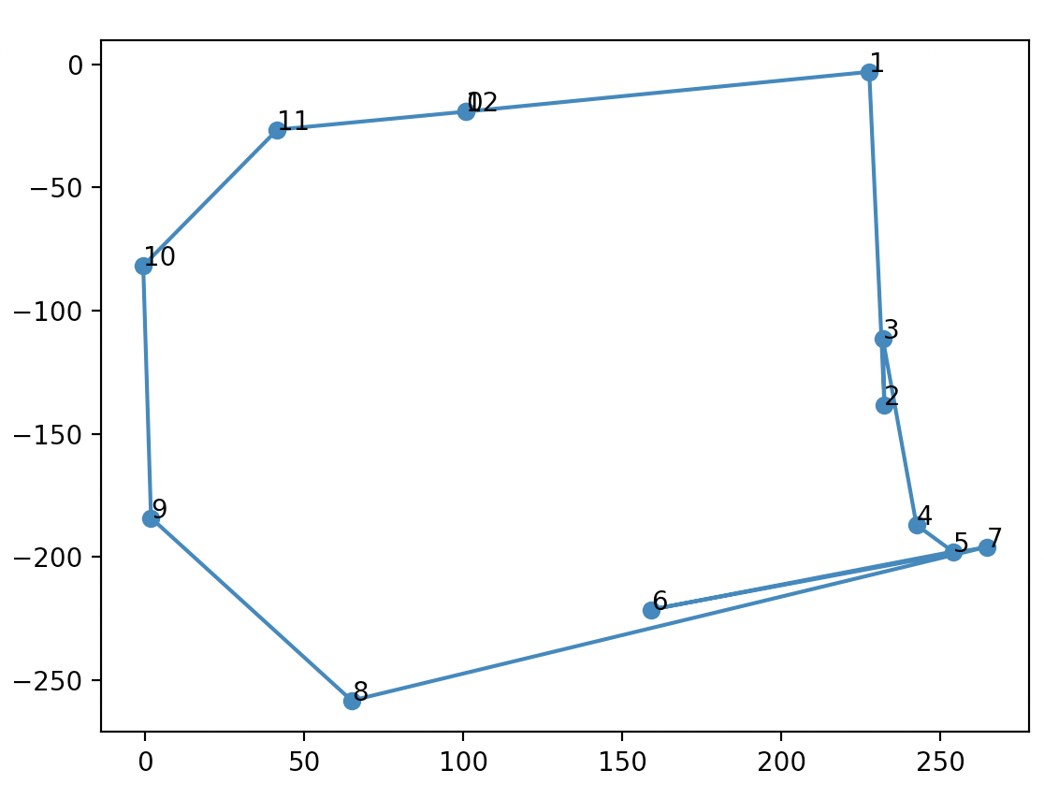

Slide 22

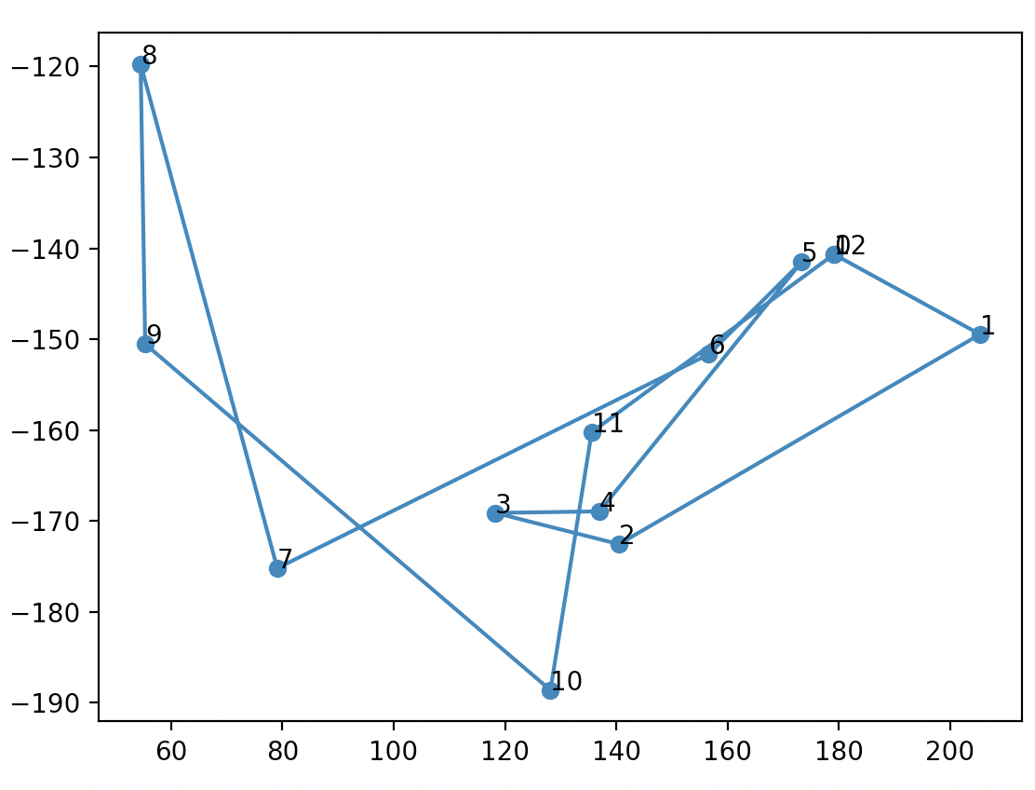

Slide 23
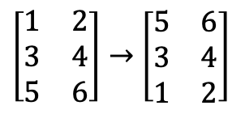
$\left[\begin{matrix}1 & 2 \\ 3 & 4 \\ 5 & 6\end{matrix}\right]→$ $\left[\begin{matrix}5 & 6 \\ 3 & 4 \\ 1 & 2\end{matrix}\right]$

Slide 25




Slide 42
A | B
B | C
A | B | C | D | E
C | D
D | E
E | A

